Slide 1
8
7
6
5
4
3
2
1

Slide 2
How to play
You will need 20 counters/ coins/ sweets for each player.
There will be 8 multiple choice questions. For each question you need to place your counters on A/B/C or D. You must leave at least one answer blank.
Once you have placed your counters click to the next slides to reveal the answer. You only keep the counters that were on the correct answer for the next question.
Good Luck!

Slide 3
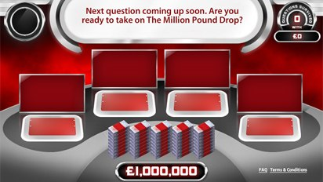
How many times have England won the mens FIFA World Cup
0
5
1
13
B
C
A
D
£???????????

Slide 4
7
6
5
4
3
2
1

Slide 5
What surface is the Wimbledon Tennis Championships played on?
Hardcourt
Clay
Carpet
_{Grass}
B
C
A
D
£???????????

Slide 6
6
5
4
3
2
1

Slide 7
Which of these sports has 7 players?
Baseball
Netball
Football
Cricket
B
C
A
D
£???????????

Slide 8
5
4
3
2
1

Slide 9
In which year were the Olympics held in London?
2002
2018
2010
2012
B
C
A
D
£???????????

Slide 10
4
3
2
1

Slide 11
How many holes are there on a standard golf course?
3
9
18
50
B
C
A
D
£???????????

Slide 12
3
2
1

Slide 13
In which sport might you do a slam dunk?
Basketball
Diving
Swimming
Football
B
C
A
D
£???????????

Slide 14
2
1

Slide 15
What distance is The Stawley School running track? (length of the field)
400m
200m
800m
60m
B
C
A
D

Slide 16
1

Slide 17
Which sport takes place in a Velodrome?
Cycling
Table Tennis
Netball
Snooker
B
C
A
D

Slide 18
Email Mr Stirzaker your score on
class3.sch313@educ.somerset.gov.uk
Thanks for playing!

